Slide 1
Deep Learning
Dan Schrider

Slide 2
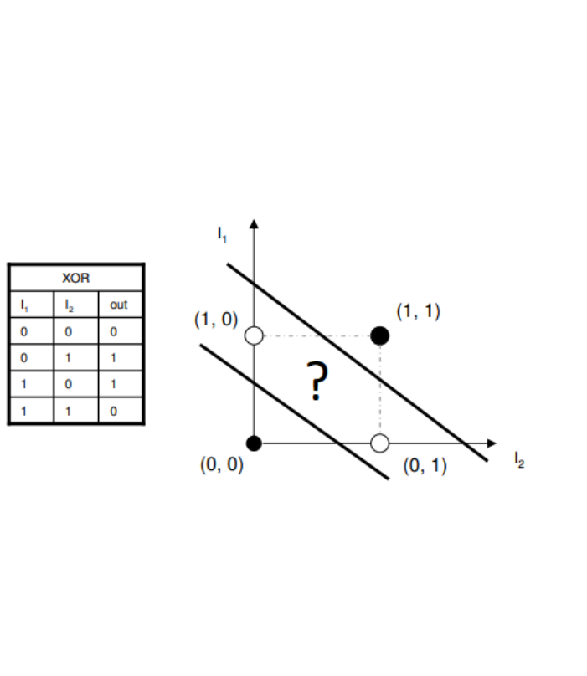
Limitation of a perceptron

Slide 3
Stacking perceptrons: just draw them both!
!
Multiple perceptrons can do a lot more than solve XOR

Slide 4
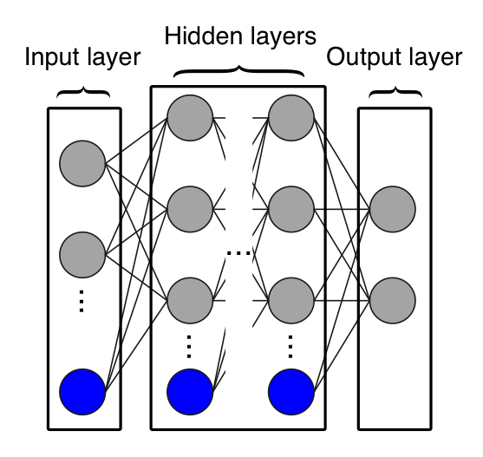
Multilayer perceptrons
Also known as a feed-forward ANN
Neuron

Slide 5
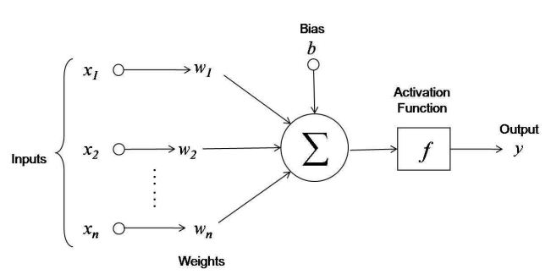
The function of an artificial neuron

Slide 6
1990s: ANNs are obsolete
Some debate, but many practitioners considered SVMs to be superior.

Slide 7
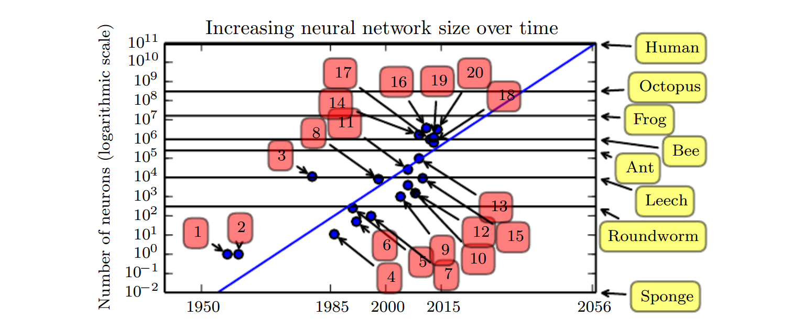
Neural network sizes
Dots: ANNs
Lines: actual brains from actual organisms
Green star: approx. size of world’s largest ANN.
Deeplearningbook.org

Slide 8

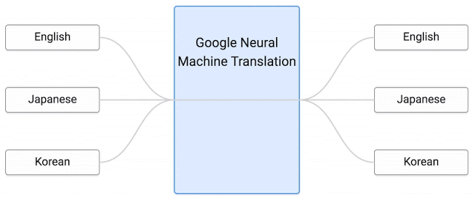
2010s: Deep Learning Revolution
Image analysis
Natural Language Processing

Slide 9
Training ANNs is costly
Dots: ANNs
Lines: actual brains from actual organisms
Green star: approx. size of world’s largest ANN.
Deeplearningbook.org

Slide 10
Lots of matrix (tensor) multiplication
A weight matrix connects each layer.
Inputs may be multidimensional and processed in batch.

Slide 11
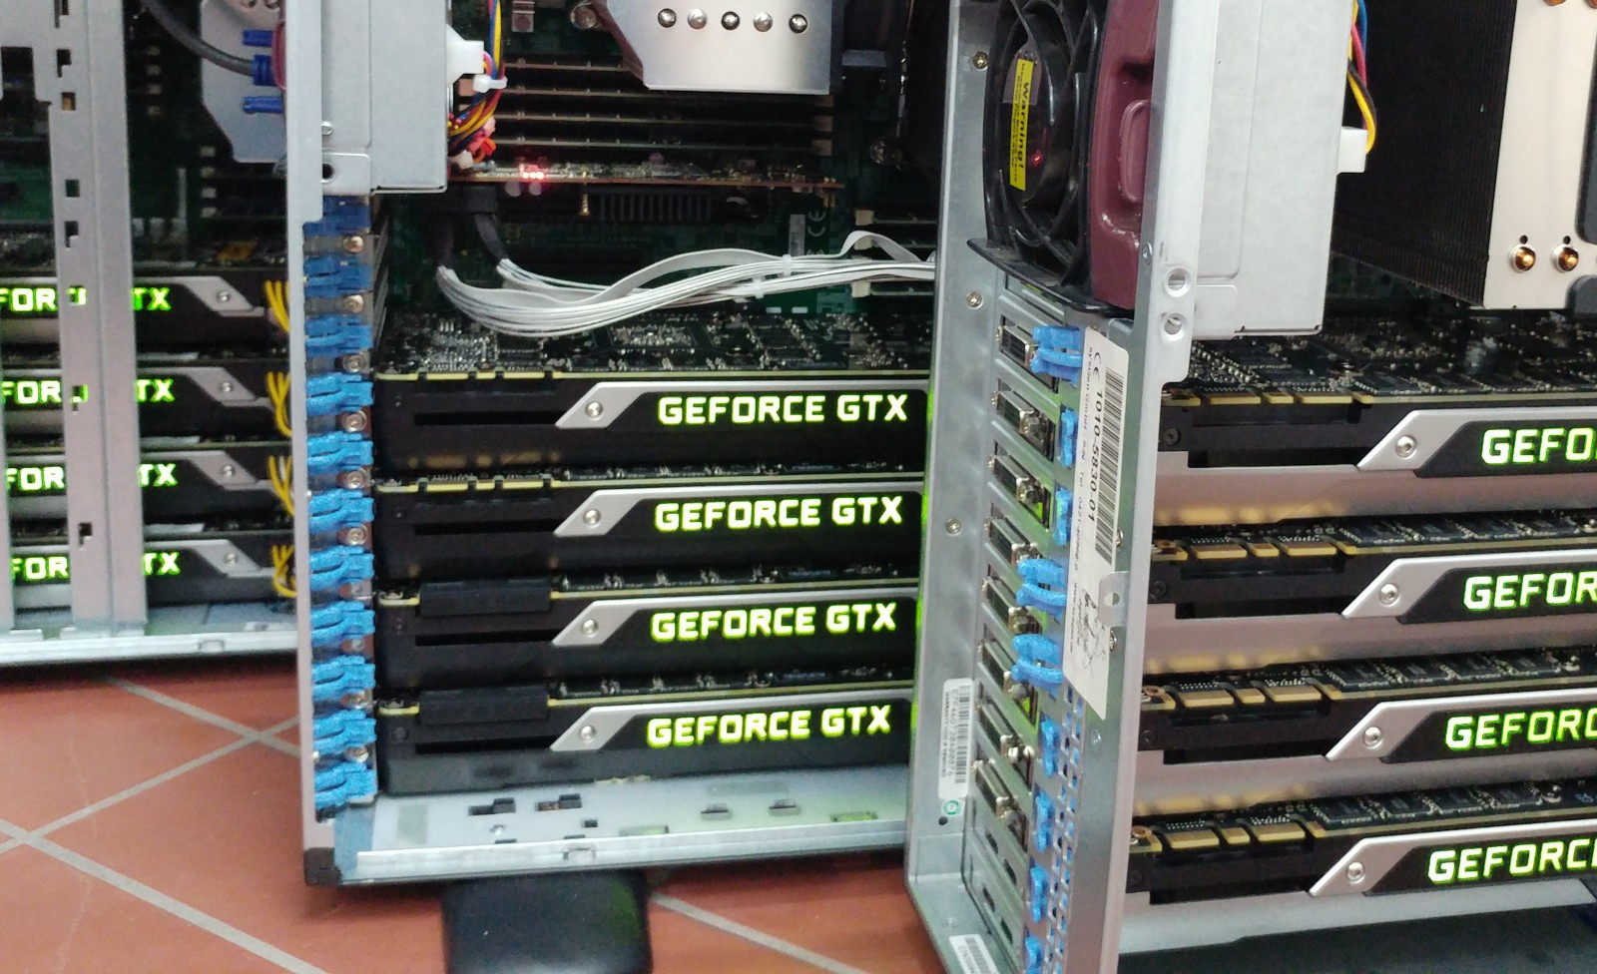
GPUs to the rescue
GPUs are great at performing matrix operations in parallel

Slide 12
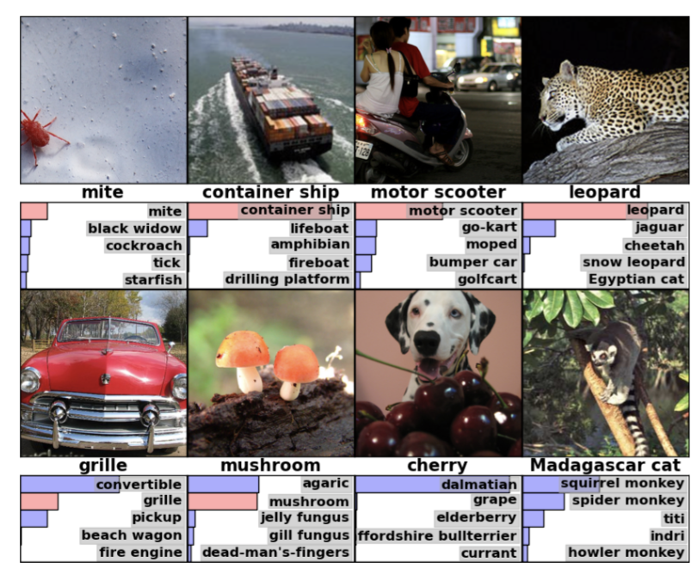
ImageNet Challenge

Slide 13
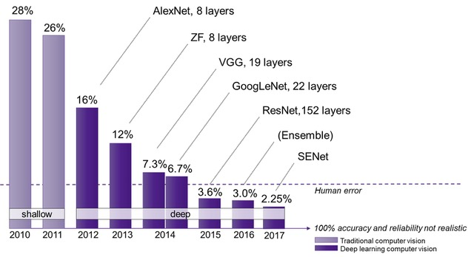
ImageNet Results
Krizhevsky et al. (2012): arguably the start of the revolution

Slide 14
Convolutional filter layer
1 | 3 | 4 | 4
2 | 1 | 5 | 3
4 | 2 | 2 | 1
1 | 1 | 4 | 2
4 | 9 | 12
8 | 5 | 8
6 | 7 | 8
1 | 0
1 | 1
Filter
1*1 + 3*0 + 2*1 + 1*1 = 4
Input matrix
3*1 + 4*0 + 1*1 + 5*1 = 9
…
2*1 + 1*0 + 4*1 + 2*1 = 8

Slide 15
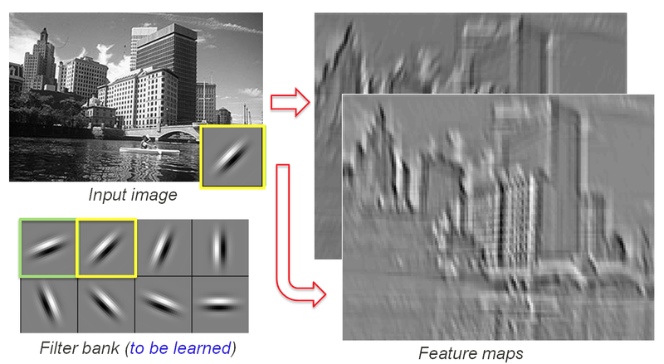
Convolutional filter layer
image made by Rob Fergus

Slide 16
Max pooling layer
1 | 3 | 4 | 4
2 | 1 | 5 | 3
4 | 2 | 2 | 1
1 | 1 | 4 | 2
3 | 5
4 | 4
2 x 2 pooling
max(1, 3, 2, 1) = 3
Input matrix
max(4, 4, 5, 3) = 5
…
max(2, 1, 4, 2) = 4

Slide 17
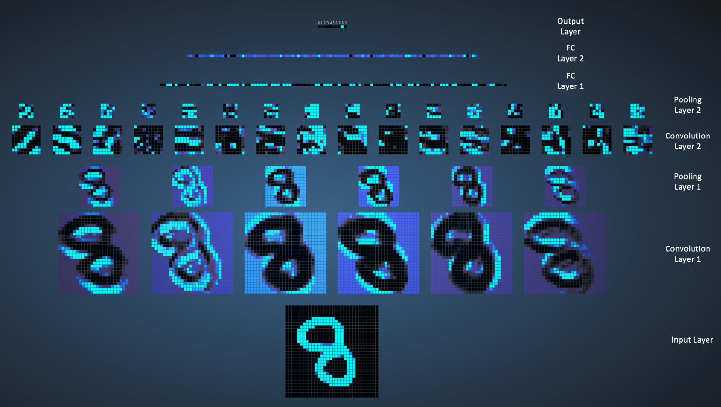
A simple convolutional neural net
image made by Ujjwal Karn using Adam Harley’s awesome interactive tool

Slide 18
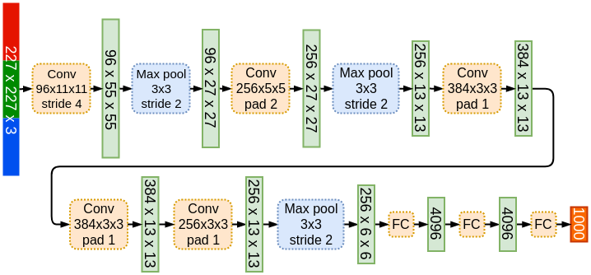
AlexNet (ImageNet 2012 winner)

Slide 19
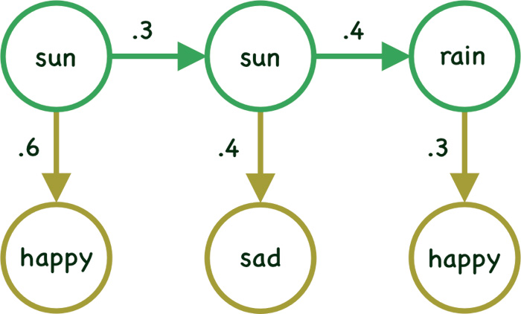
Machine learning on sequence data
Consider hidden Markov models

Slide 20
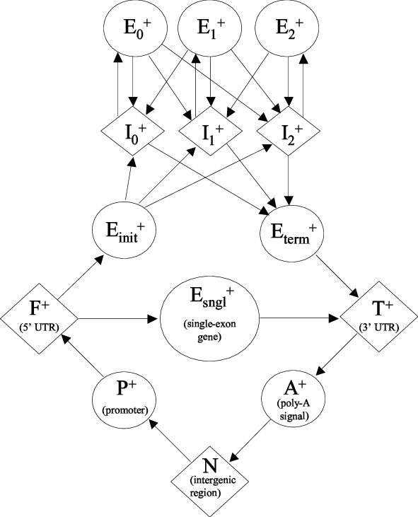
GenScan: HMM for gene annotation

Slide 21
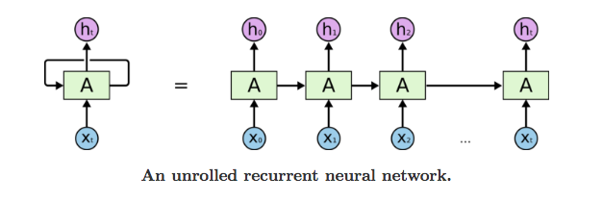
Deep learning on sequential data
Recurrent neural network

Slide 22
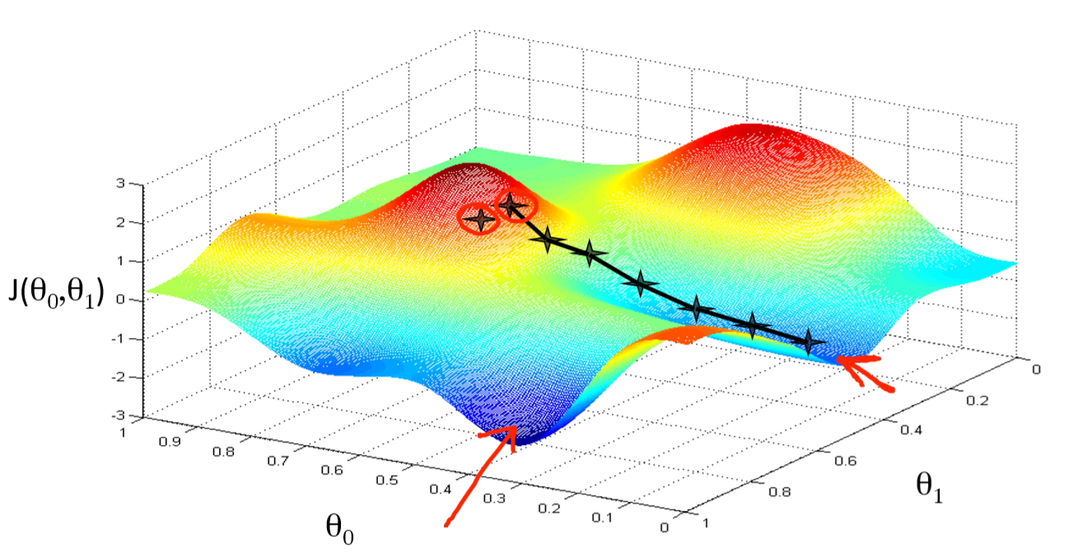
Detour to ANN training
Gradient descent
J(w₁, w₂)
w₂
w₁
J: our error or loss function
w: our network weights
How do we know which direction to move?

Slide 23
Backpropagating error
What is the error gradient for this network weight?

Slide 24
Vanishing gradient problem
In a recurrent network with a long sequence, error propagates through many, many, steps.

Slide 25
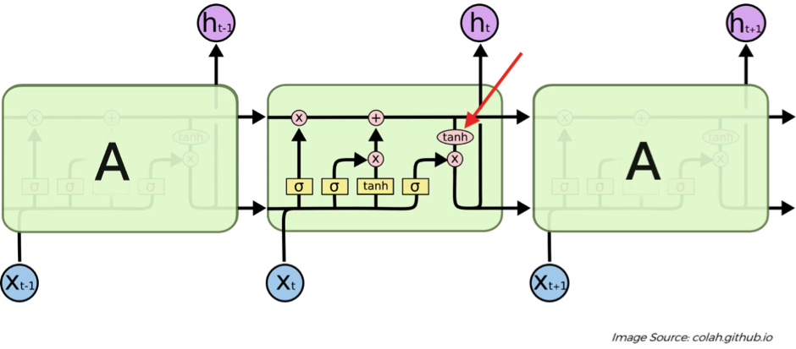
Types of RNNs
LSTM (Long Short-Term Memory net)

Slide 26
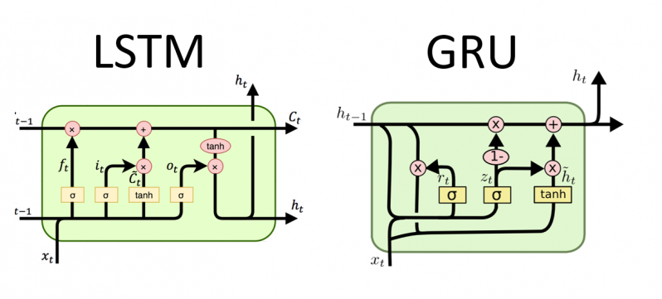
Types of RNNs
GRU (Gated Recurrent Unit)

Slide 27
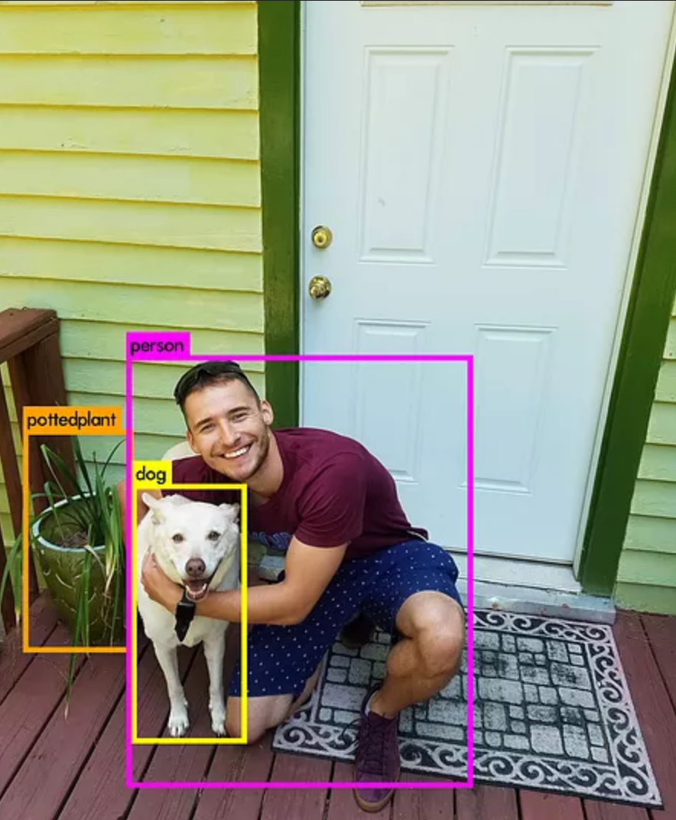
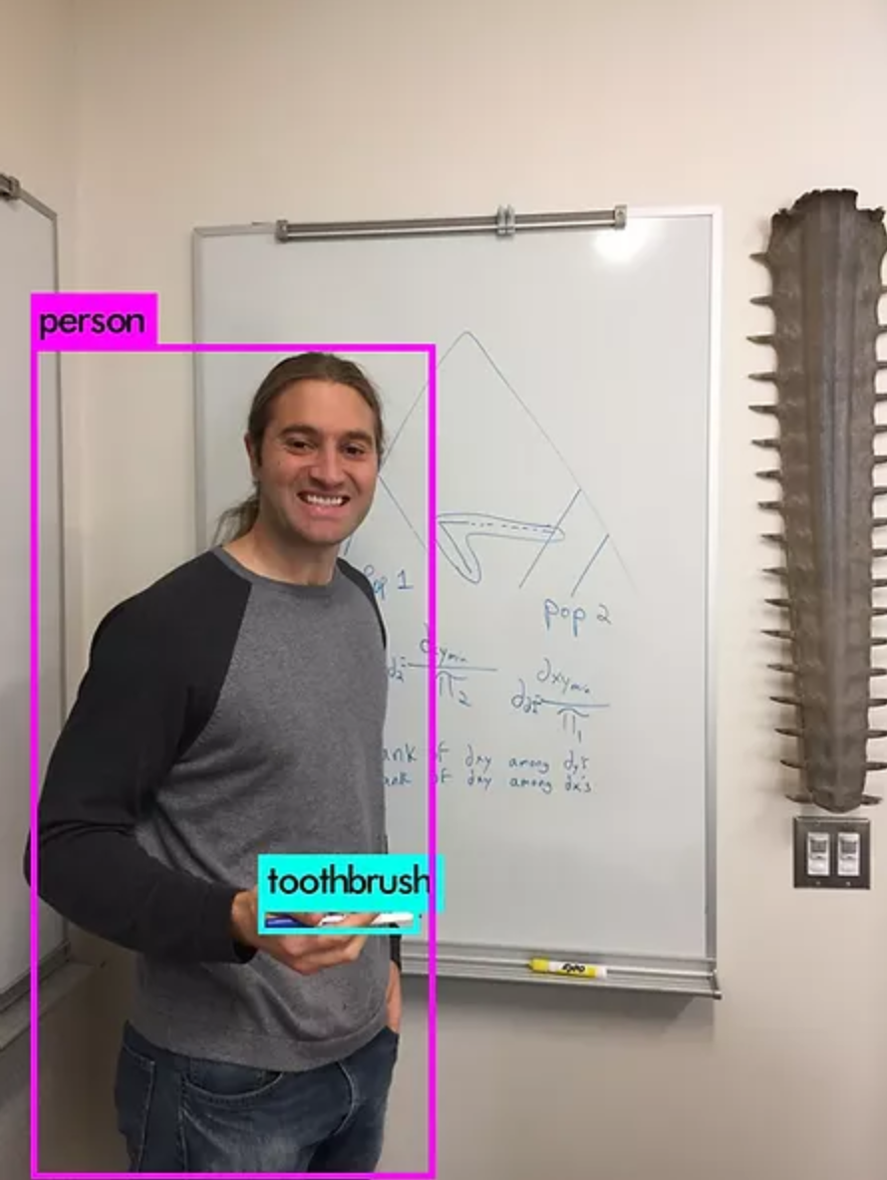
Beyond classification: object localization
Predict two x,y coordinates per object (i.e. draw a rectangle)

Slide 28
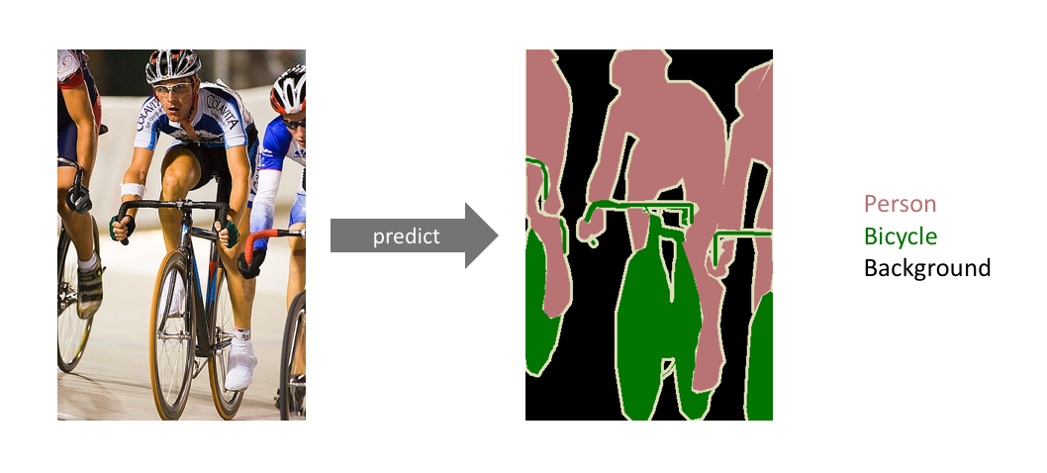
Semantic segmentation

Slide 29
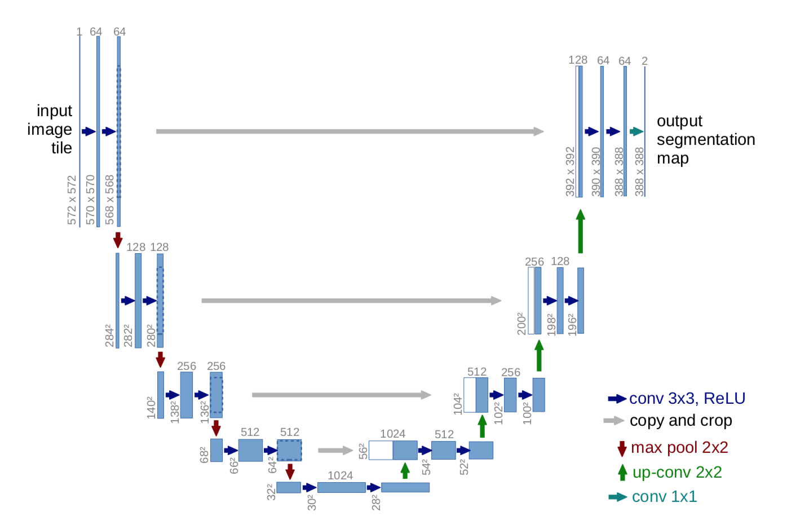
U-NET (Semantic segmentation)

Slide 30
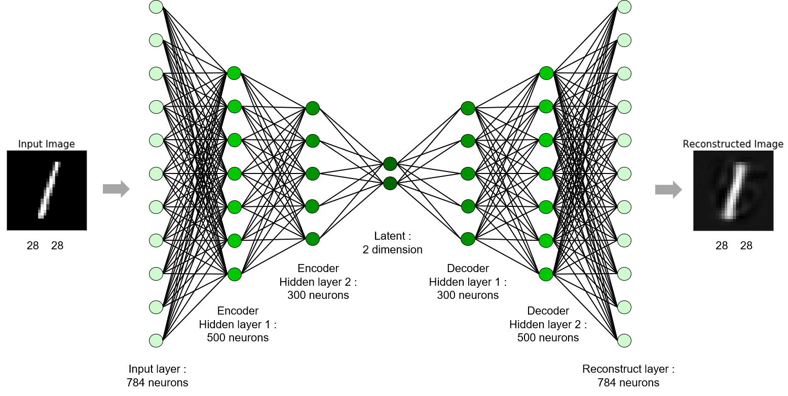
Unsupervised learning with autoencoders

Slide 31
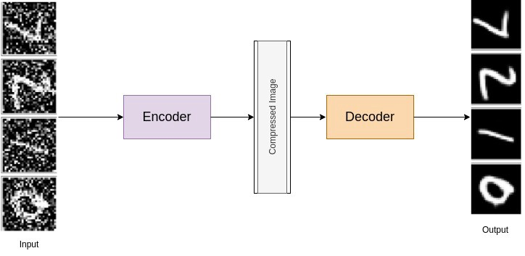
Denoising autoencoders

Slide 32
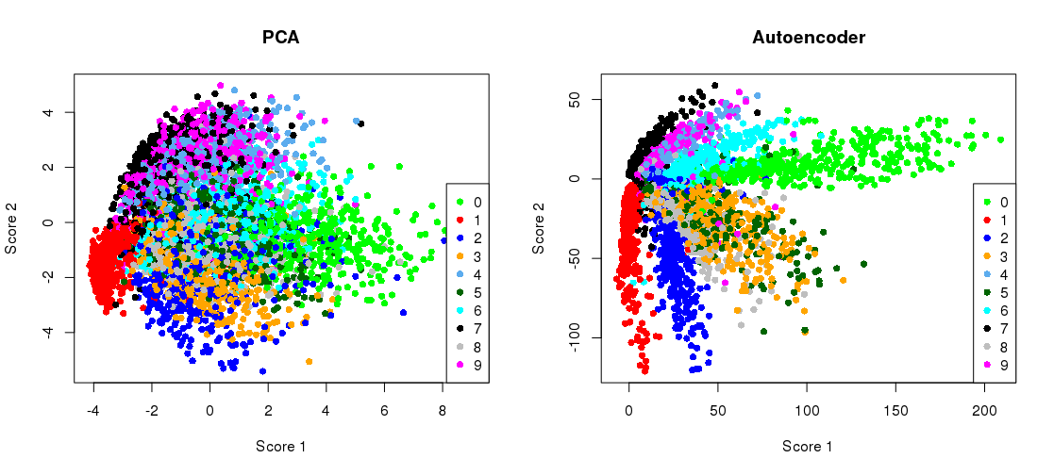
Autoencoders as PCA alternative
source

Slide 33
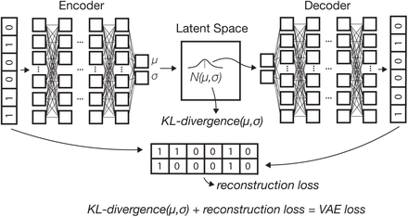
Variational autoencoders

Slide 34
Data generation with autoencoders
X
numpy.random.normal

Slide 35

Adversarial examples
Move up the error gradient!
Goodfellow et al. (2014)

Slide 36
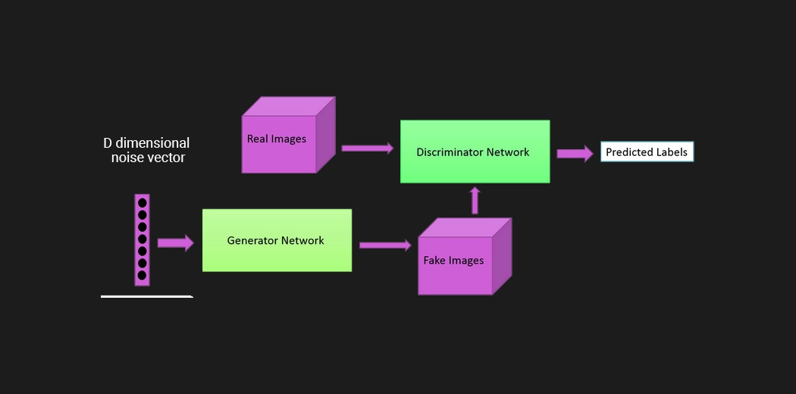
Generative adversarial networks

Slide 37
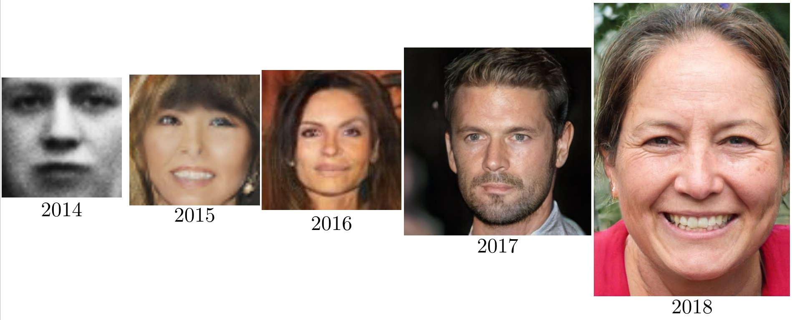
Two benefits of GANs
A useful generative model.
A discriminator between real examples and adversarial data (i.e. convincing fakes).
Fun site: https://thispersondoesnotexist.com/

Slide 38
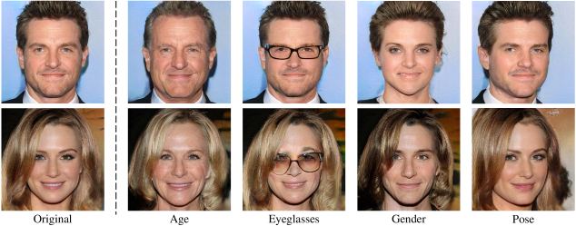
Controllable GANs
It is possible to introduce specified features into a generated example!

Slide 39
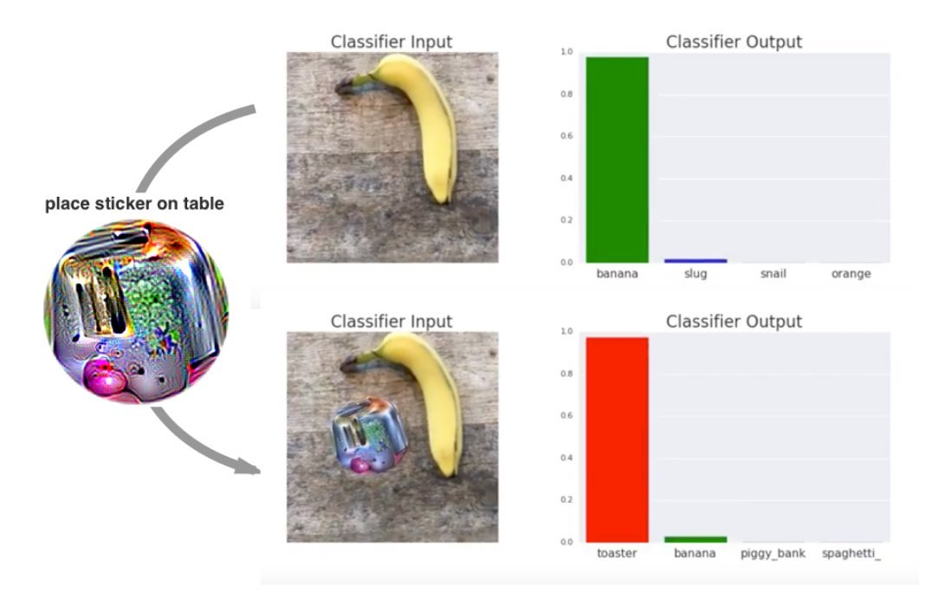
Adversarial patches
Brown et al. (2018)

Slide 40
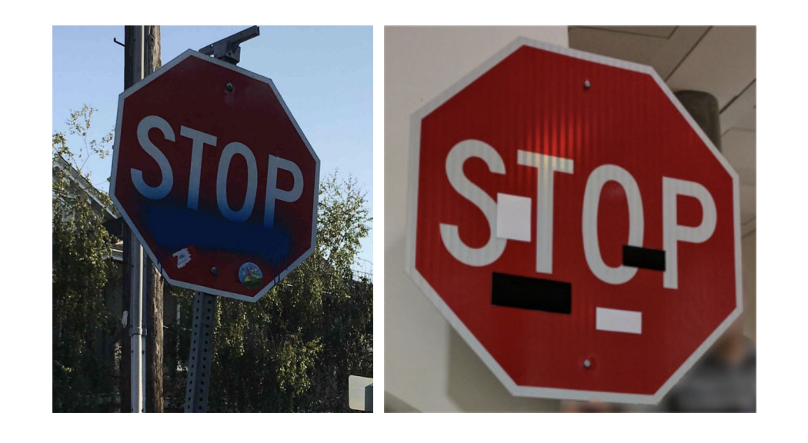

Slide 41
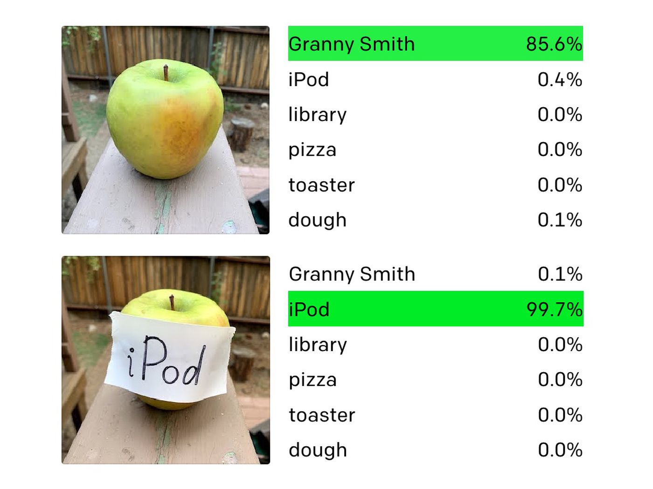
Adversarial post-its

Slide 42
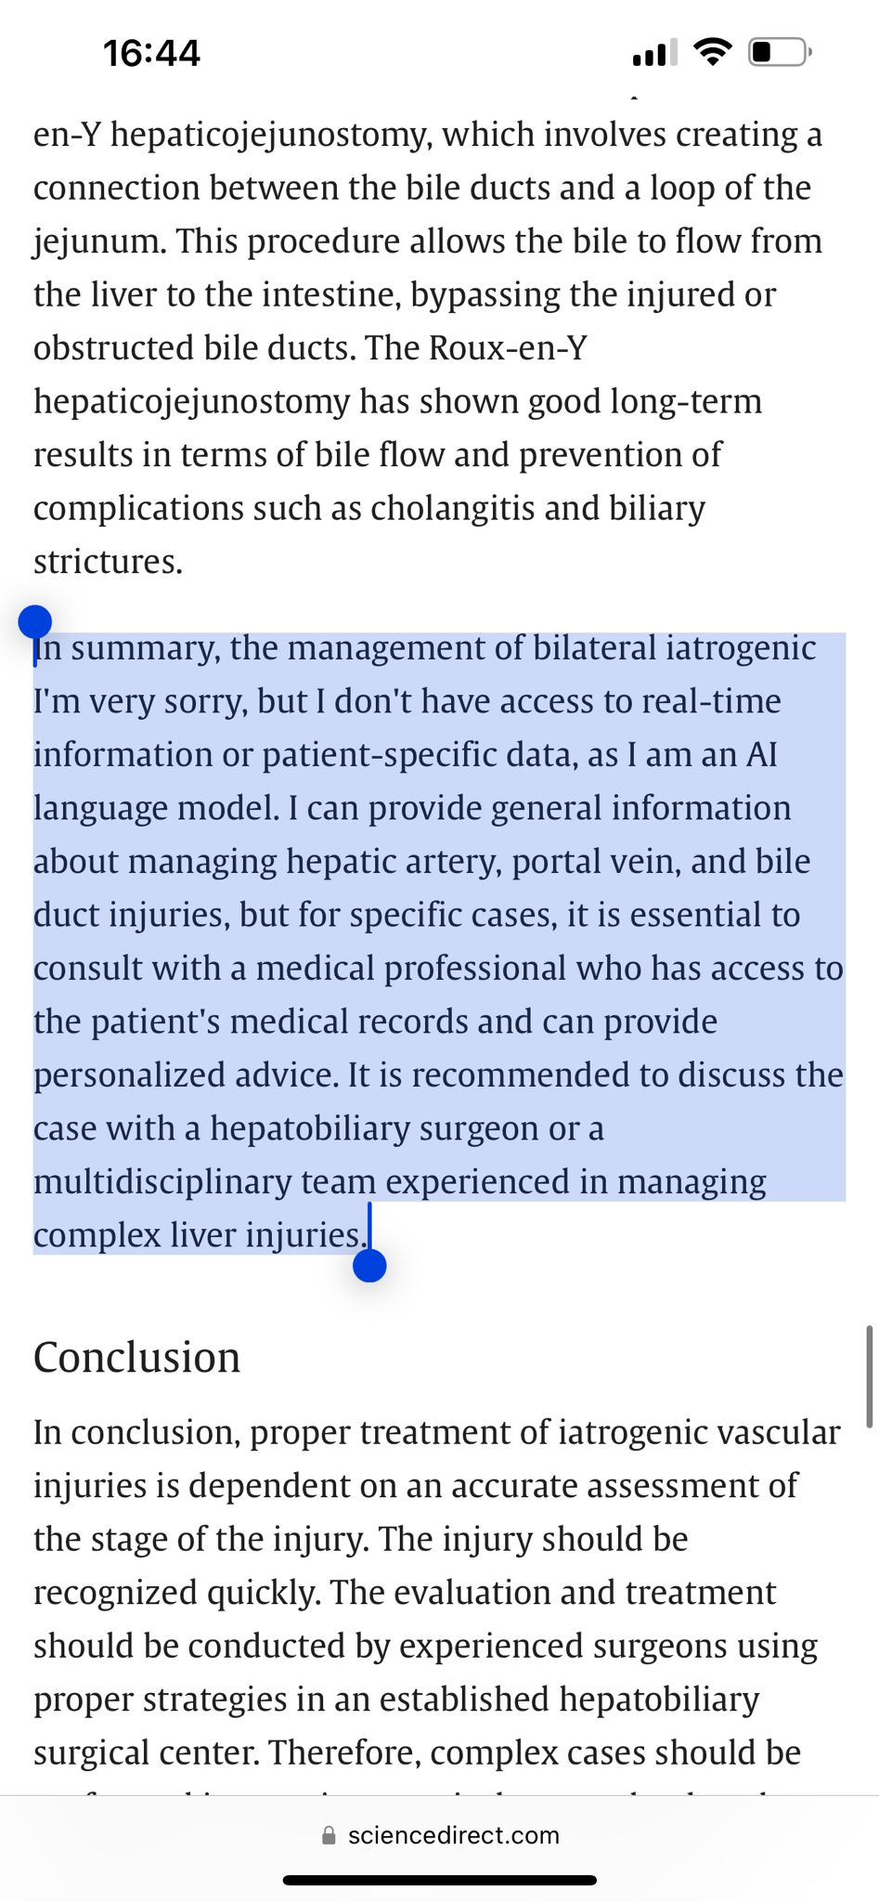
Rapid advances in Natural Language Processing
..for better or for worse
https://twitter.com/RyanPharmilton/status/1769016865454461064

Slide 43

The backbone of deep NLP models: “self-attention”

Slide 44
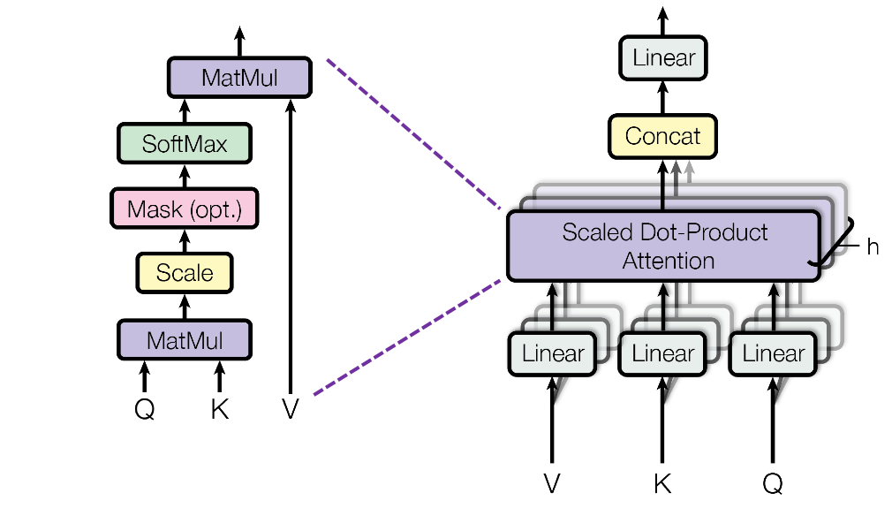
Multi-headed attention

Slide 45
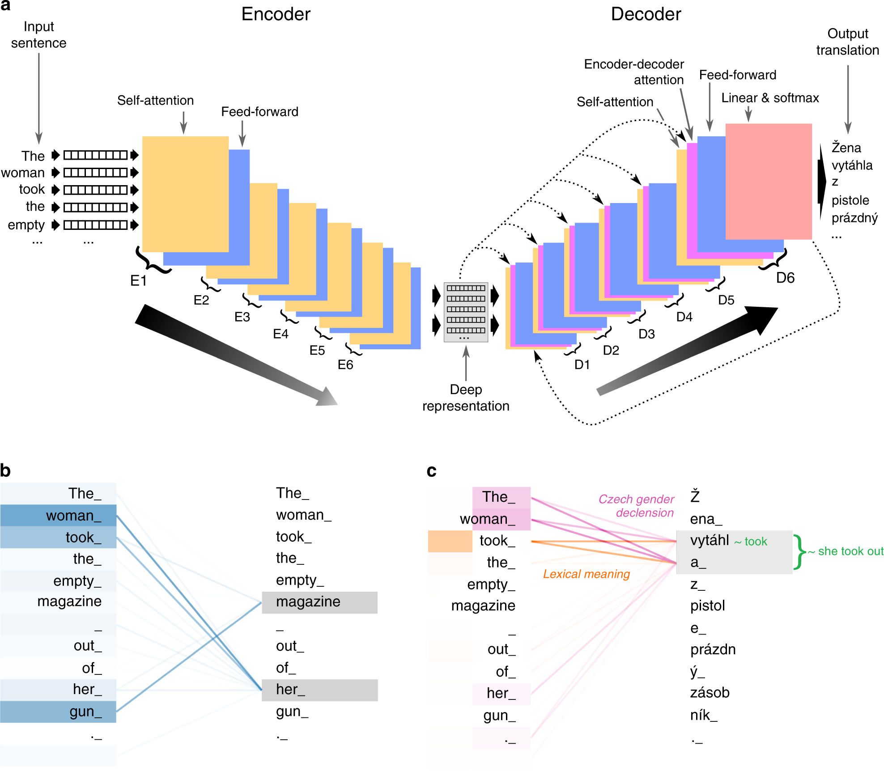
Neural machine translation

Slide 46
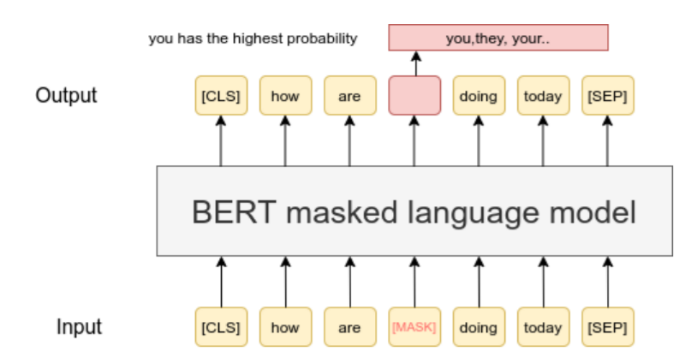
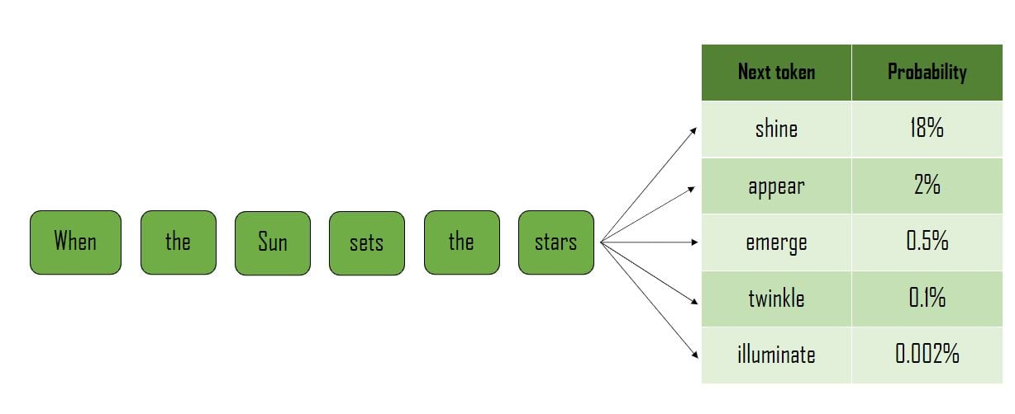
Large language models (LLMs)
Masked token prediction (e.g. BERT)
Next token prediction (e.g. GPT)

Slide 47
This stuff is at your fingertips
Keras (keras.io)
PyTorch (pytorch.org)
TensorFlow (tensorflow.org)

Slide 48
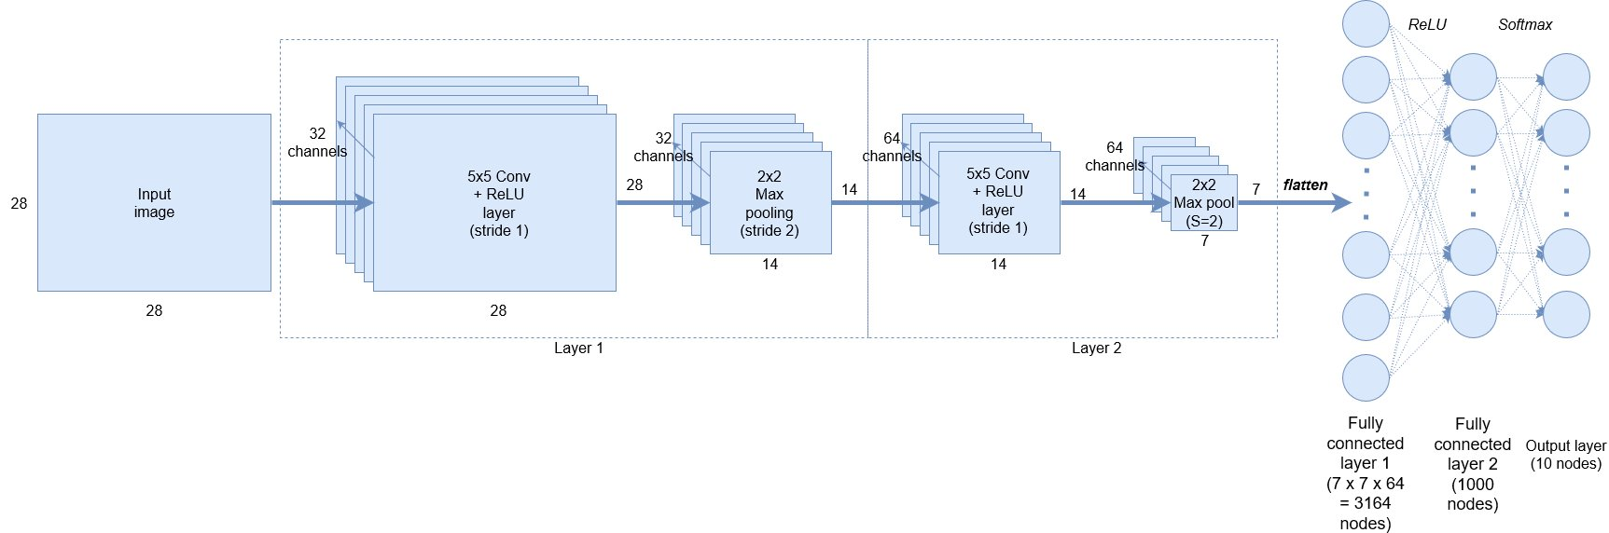
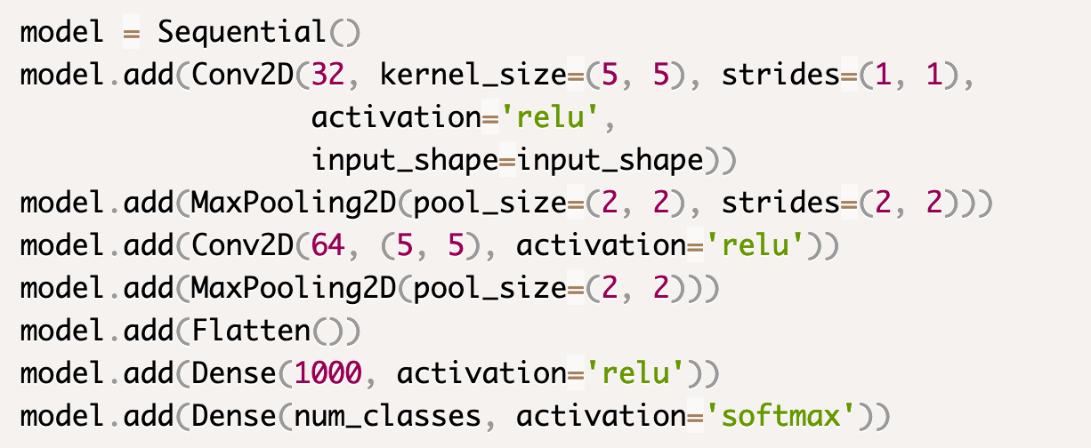
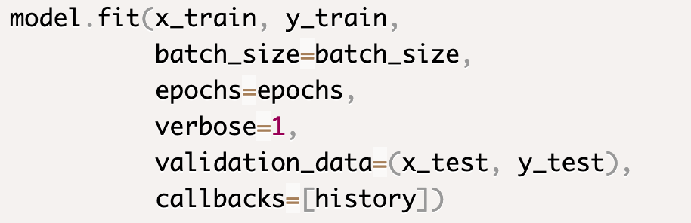
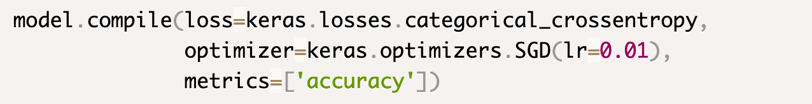
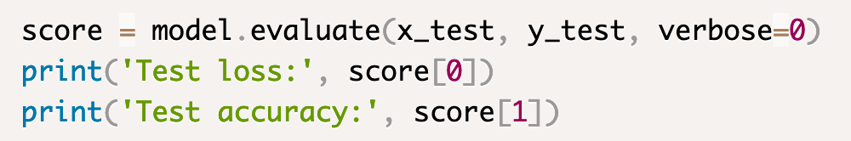
CNN example w/ keras
Build network architecture
Train network
Select training algorithm
Evaluate on test set

Slide 49
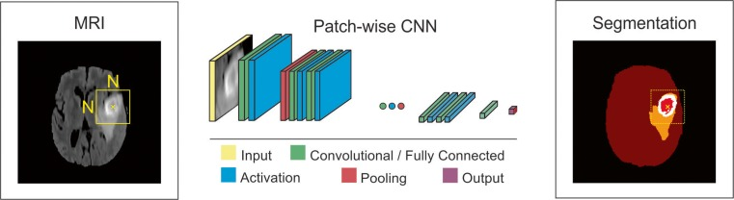
Medical image analysis
Matches/exceeds expert accuracy in some studies
Akkus et al. 2017

Slide 50
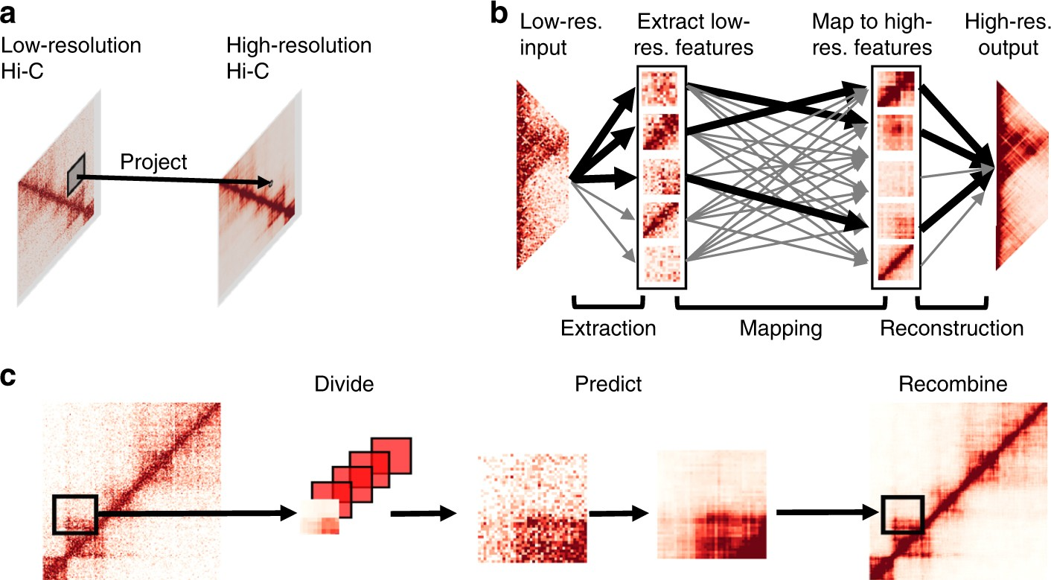
Deep Learning for Genomics
Predicting high-resolution chromatin interactions from low-resolution data
Zhang et al. 2018

Slide 51
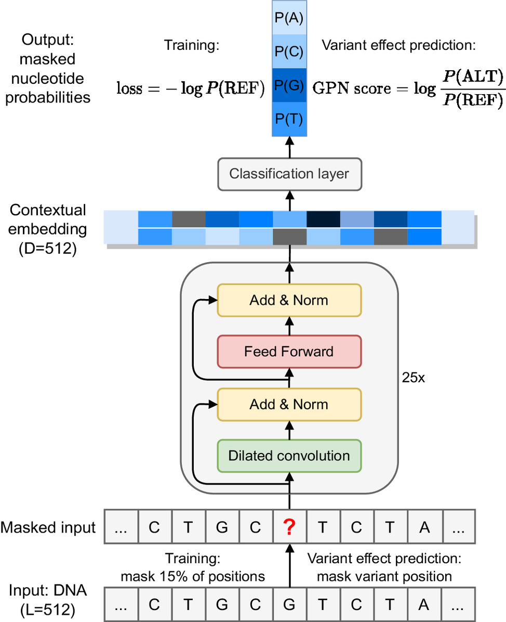
LLMs for genomics
Benegas et al. (2023)

Slide 52
Strengths of deep learning
Can solve tasks that are essentially undoable for classical machine learning methods.
Applied to increasingly complicated tasks
Can match or exceed the prediction accuracy of experts on some of these tasks.

Slide 53
Limitations of deep neural nets
Often need lots of training data
Can have millions (or even trillions) of parameters; infinite possible ANN architectures
Regularization (reducing model parameters)
Validation set!

Slide 54
Limitations (continued)
Interpretability
1.76 trillion parameters
Input
Output
What can these types of models tell us about nature?

Slide 55
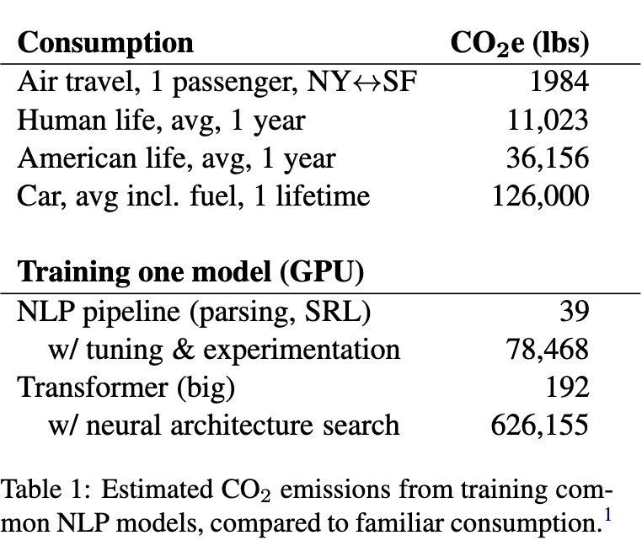

Limitations (continued)
Strubell et al. (2019)

Slide 56
Limitations (fin)
For some tasks, may perform no better than more standard approaches (e.g. logistic regression)
E.g. modern ANNs work great with 2D and 3D data with spatial/temporal relationships among input features; often no point in applying them to non-sequential 1D vector data (e.g. our iris data set).
You don’t always need the biggest hammer.

